Slide 1
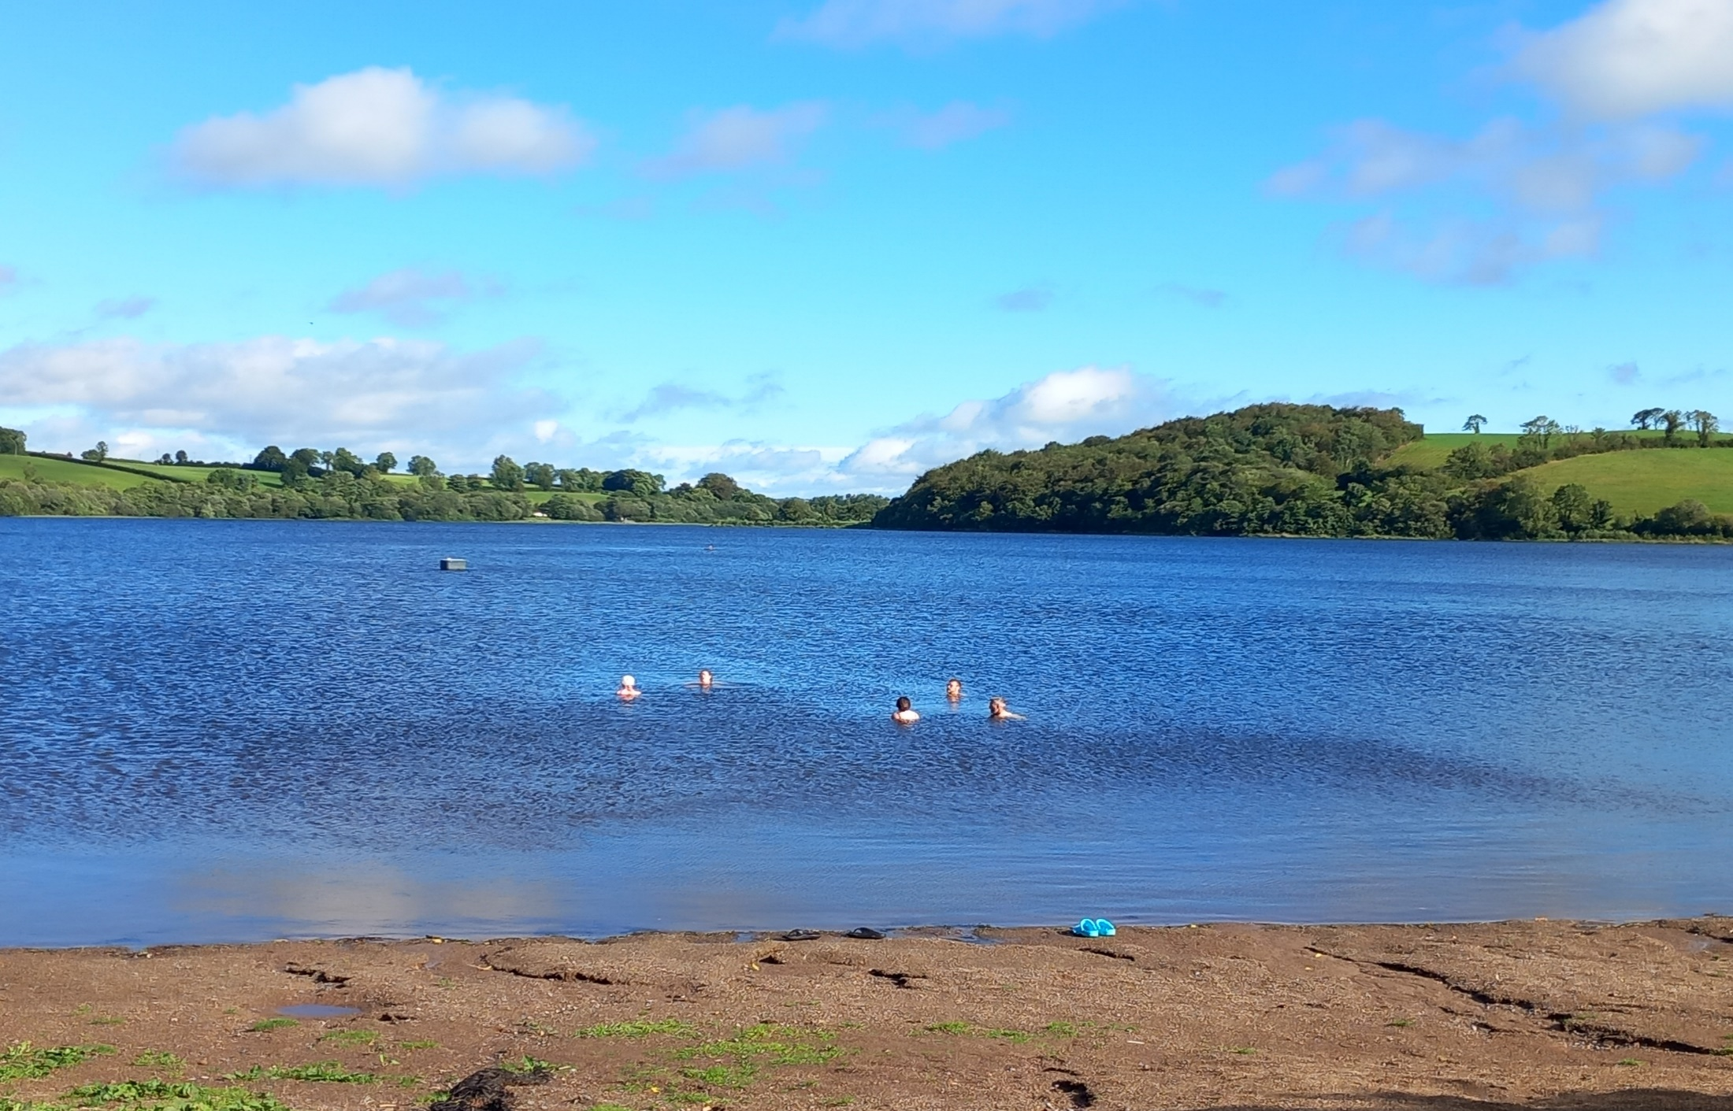
Chapter 1: Water is Essential for All Life
The global impact of how we use water
Lesson 5 – Sustainable Development and Consumerism

Slide 2
& Consumerism

Slide 3
SUSTAINABLE DEVELOPMENT allows for the satisfaction of human necessities without compromising the basis of that development, which is the environment.
Environmental Quality
Three principles underlie
sustainable development:
Sustainable
Development
Economic Security/
Prosperity
Social Justice/
Fairness
Notes:
Image by Emilian Robert Vicol from Pixabay
"Change, Freedom, Social Justice - Egypt Uprising protest Melbourne 4 Feb 2011" by John Englart (Takver) is licensed under CC BY-SA 2.0.

Slide 4
Sustainable Development
Humans are part of the natural world and are not distinct or apart from it.
We must not take our natural resources for granted, but discover the value of what we have.
We must respect and make room for nature.
Environmental Quality
People need to have a voice and feel that resources are fairly used.
20% of the world’s population, who live in the most successful economies, use around 80% of the world’s resources.
Social Justice
/ Fairness
Economic Security /
Prosperity
Economic development and growth is needed in developing countries.
Notes:
Image by Emilian Robert Vicol from Pixabay
"Change, Freedom, Social Justice - Egypt Uprising protest Melbourne 4 Feb 2011" by John Englart (Takver) is licensed under CC BY-SA 2.0.

Slide 5
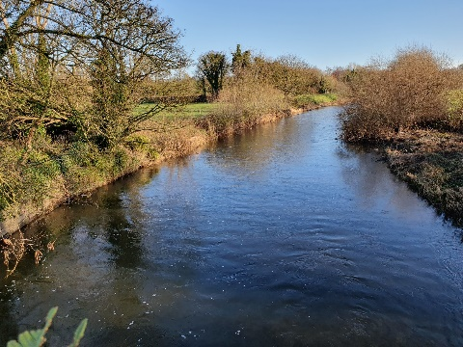
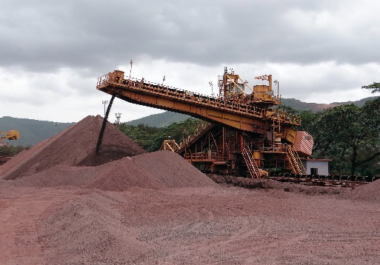
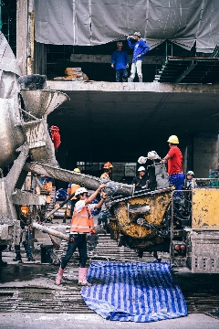
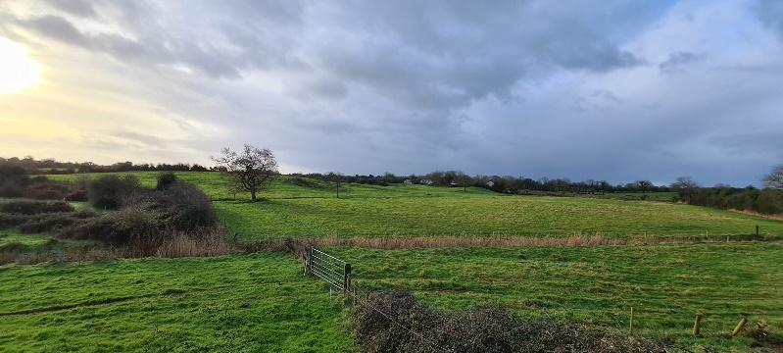
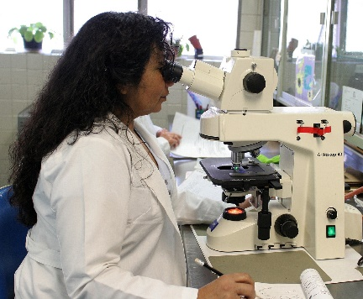
All development uses resources of one type or another,
i.e. water, land, raw materials and labour.
Iron ore
Notes:
River and Field: Maigue Rivers Trust
Iron mining Image by Bishnu Sarangi from Pixabay
Work site: Image by Igor Ovsyannykov from Pixabay
Lab image: Image by Ernesto Eslava from Pixabay

Slide 6
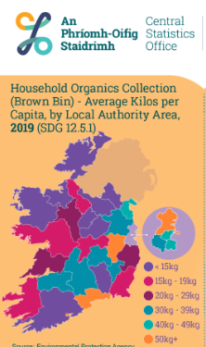
20% of the world’s population, in the most successful economies, use around 80% of the world’s resources.
Ireland is part of the 20% - and we waste kilos of food
Task 5.1
Discussion on the 3 pillar challenge:
Environmental quality: Does nature need equal rights to humans?
Social: Is it just and fair that 20% of the world’s population use 80% of the resources
Economic: How can we have economic development when we are beyond planetary boundaries already?
Notes:
Flag: Image by Pete Linforth from Pixabay
Source: https://www.activesustainability.com/environment/natural-resources-deficit/?_adin=02021864894
https://friendsoftheearth.uk/sites/default/files/downloads/overconsumption.pdf
https://www.cnbc.com/2017/09/11/were-on-track-to-triple-our-use-of-natural-resources-by-2050.html

Slide 7
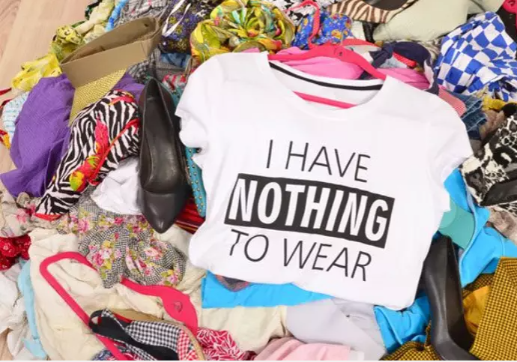
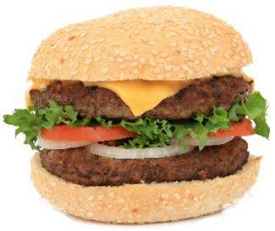
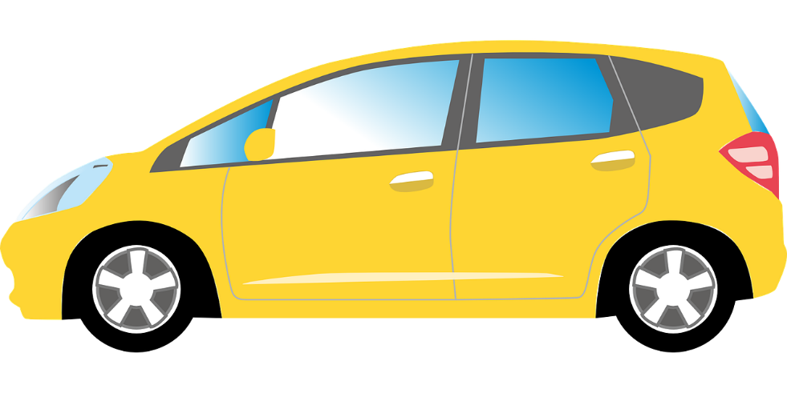
The challenge of reducing how much we consume
& resistance to change
Many people are not willing to give up or reduce their creature comforts, change their diets, heating their homes or travelling less.
Notes:
T-short photo: https://www.edie.net/fast-fashion-polyester-production-has-doubled-since-2000-with-huge-climate-implications/
Burger: Image by Robert Owen-Wahl from Pixabay
Car & Airplane Images by Clker-Free-Vector-Images from Pixabay

Slide 8
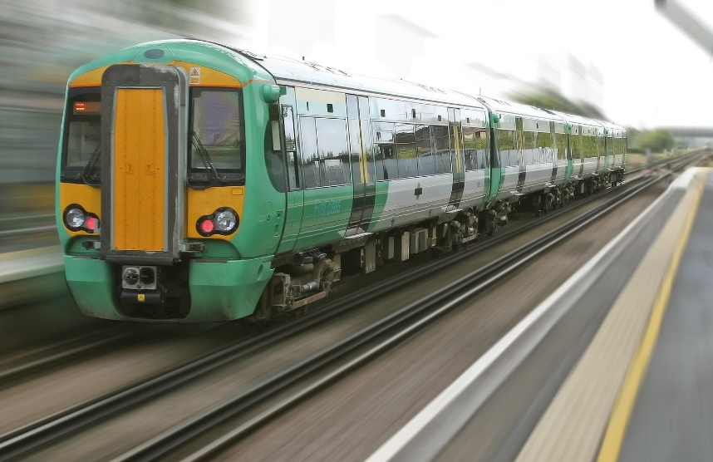
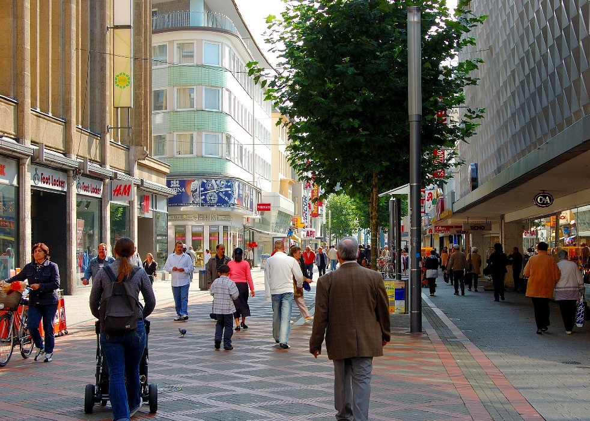
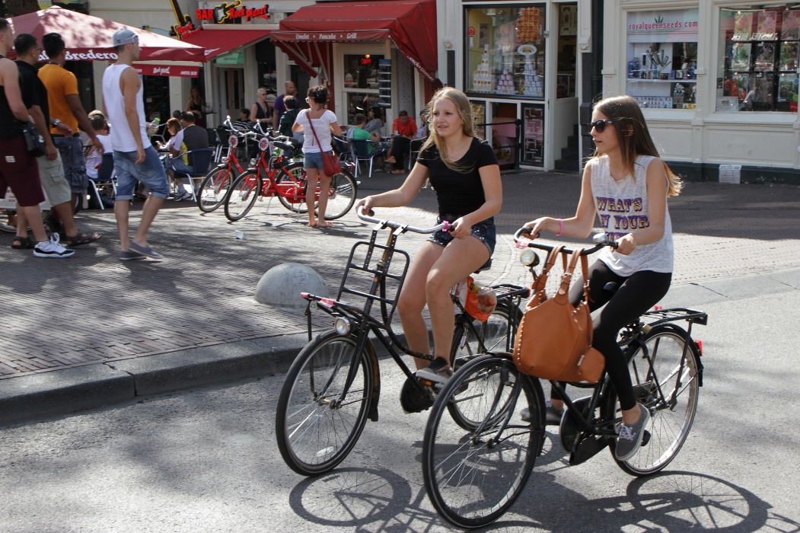
Changing how we live – alternative transport solutions
Trains
Buses
Walking
Cycling
Notes:
Train Image by Robert Owen-Wahl from Pixabay
Bus/Tram Image by Emslichter from Pixabay
Pedestrians Image by Jörg Möller from Pixabay
Cyclists Image by Robert Armstrong from Pixabay

Slide 9
Does Consumerism have a role to play in resource consumption?
Definition
Consumerism promotes the acquisition of goods, and especially the purchase of goods, as a means for personal satisfaction and economic stimulation.
Source: https://www.merriam-webster.com/dictionary/consumerism
& https://www.techtarget.com/whatis/definition/consumerism
Notes:
Source: https://www.merriam-webster.com/dictionary/consumerism
https://www.techtarget.com/whatis/definition/consumerism

Slide 10
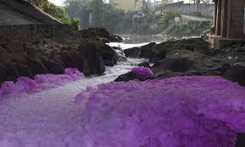
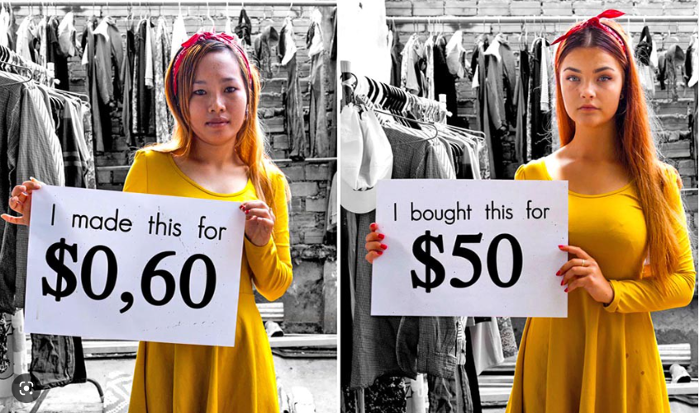
Task 5.2
What does the term Fast Fashion mean to you?
Can you name any brand examples?
Consider - Should we boycott fast fashion?
Dyes dumped in rivers by fast fashion factories.
Photo credit: Greenpeace.
The fashion industry consumes one tenth of all of the water used industrially to run factories and clean products.
Notes:
Photo credit: https://medium.com/maverickyouth/inside-the-ugliness-of-the-fast-fashion-industry-ac40f6a24e01
Information source: https://earth.org/fast-fashion-pollution-and-climate-change/
Source: Gigie Cruz-Sy / Greenpeace

Slide 11
Task 5.2
Organise an information campaign on fast fashion
What are the problems with fast fashion?
Notes:
Image source: https://www.checinternational.org/wp-content/uploads/2022/02/What-Are-the-Problems-With-Fast-Fashion.jpg

Slide 12
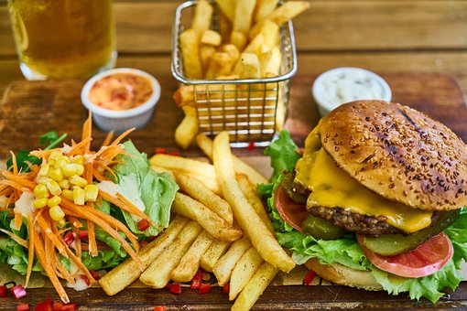
Task 5.3
Debate suggestion:
Would you consider reducing your meat intake for environmental sustainability reasons?
Can you present reasons to eat meat?
Can you present reasons not to eat meat?
Class decides on the winning argument
Water Footprint
Notes:
Fast food: Image by Engin Akyurt from Pixabay
Pasta Salad : Image by Pexels from Pixabay

